Slide 1








Truck-Fleet Risk Analysis

Slide 2



Agenda
Problem Statement
Risk Model by
Drivers
Risk Model due
to Incidents
Process Flow
Risk Model by Count
Risk Model due to Speed
Conclusion

Slide 3

Problem Statement
To predict risk factors for drivers based on events, total distance, average speed, and
mileage
Identify risky drivers, on a scale of 1 – 10, by analyzing data on location, vehicles, mileage, gas consumption, events, and risk factors
To reduce driver risks and help prevent accidents involving large commercial trucks in
the US, minimizing injuries and deaths

Slide 4

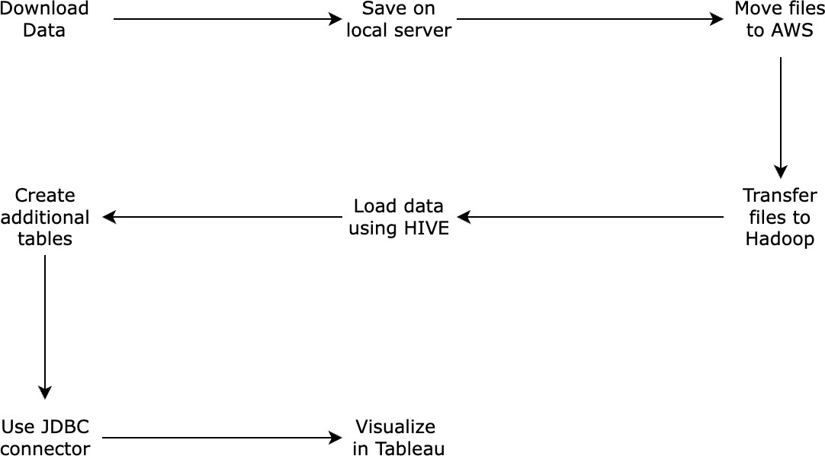
Process Flow

Slide 5
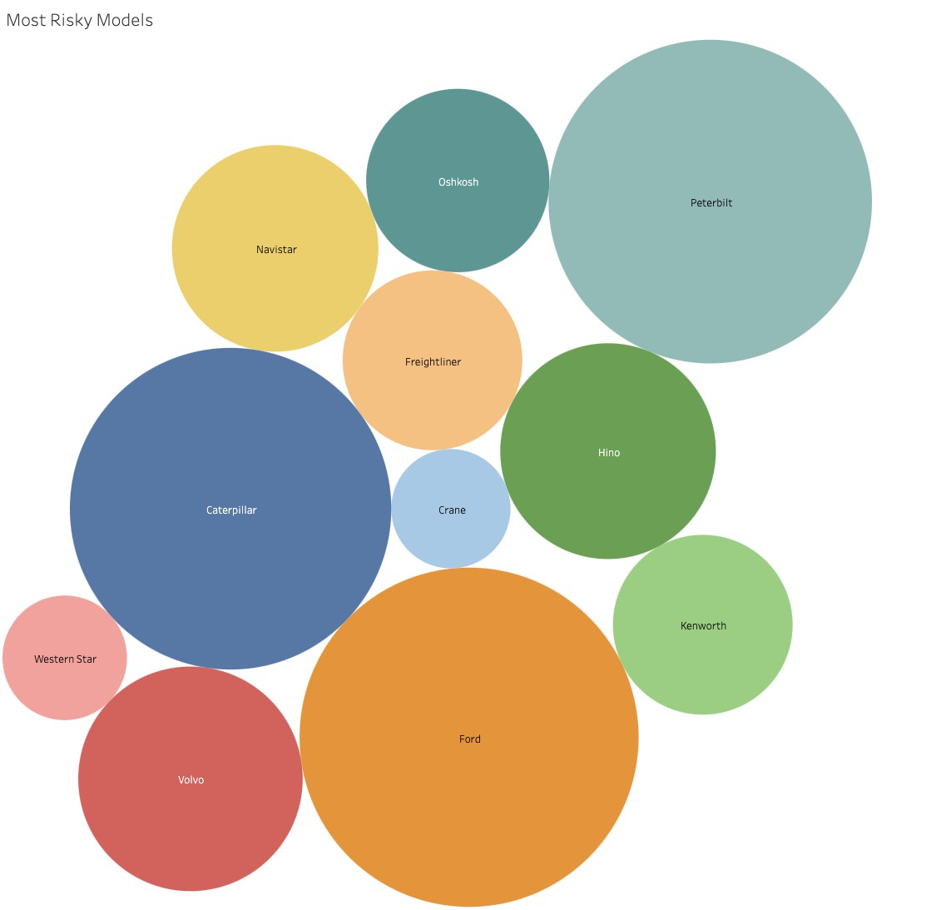
Dashboard 1 - Risk Model by Count
The color and size represents the
event count by model
By observation – Ford, Caterpillar and Peterbilt are the largest representation

Slide 6
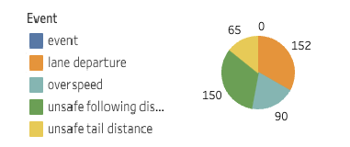
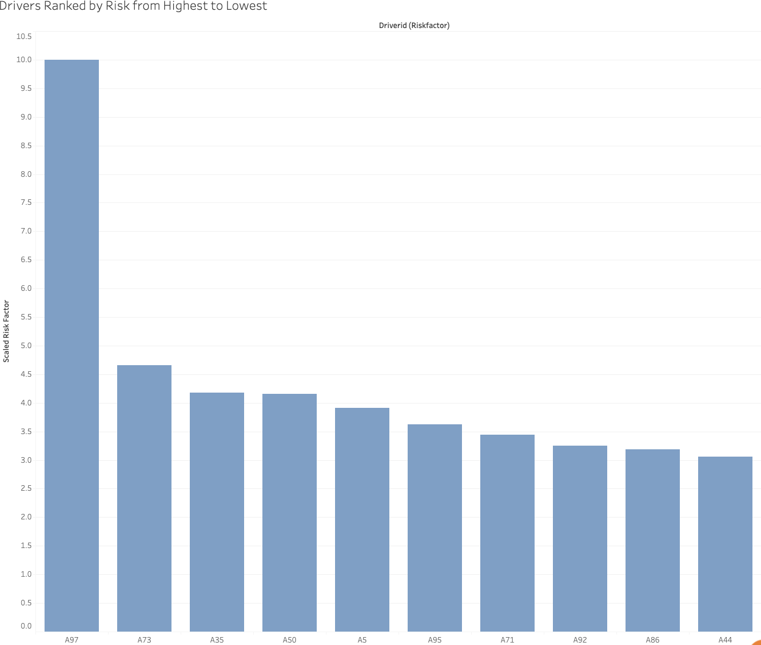
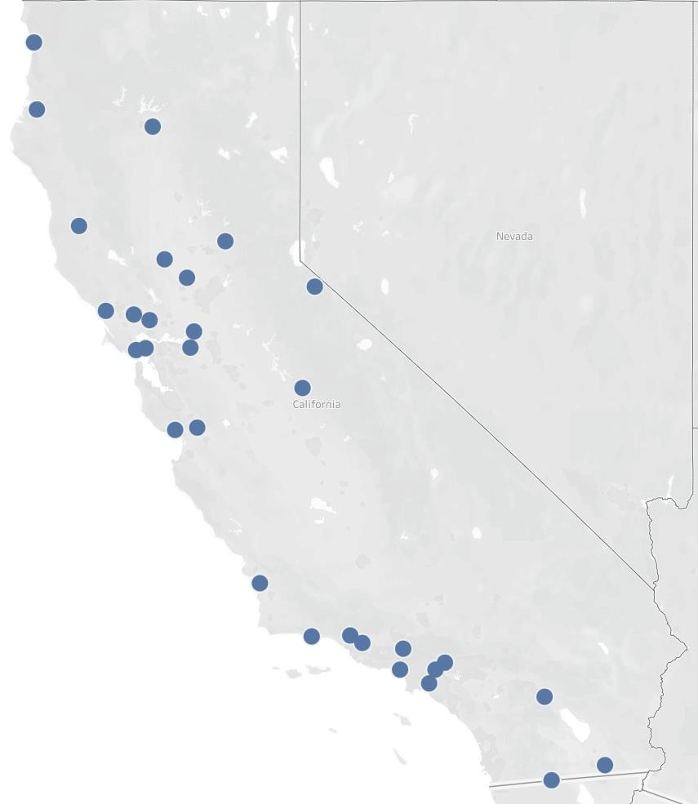
Dashboard 2 - Risk Model by Drivers

Slide 7
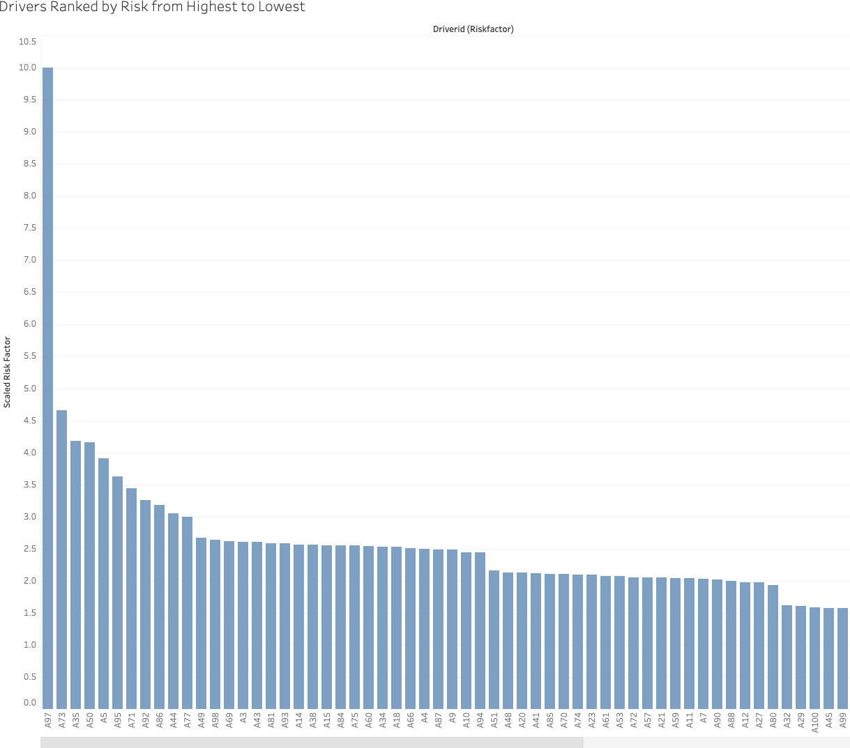
Dashboard 2 - Risk Model by Drivers
Model shows the scaled Risk Factor
Analysis of drivers
The model highlights the riskiest driver, "A97", with a risk factor of 10, significantly higher than any other driver
The second-highest risk, associated with Driver "A73", is 4.6, indicating that Driver "A97" is more than twice as risky compared to "A73

Slide 8
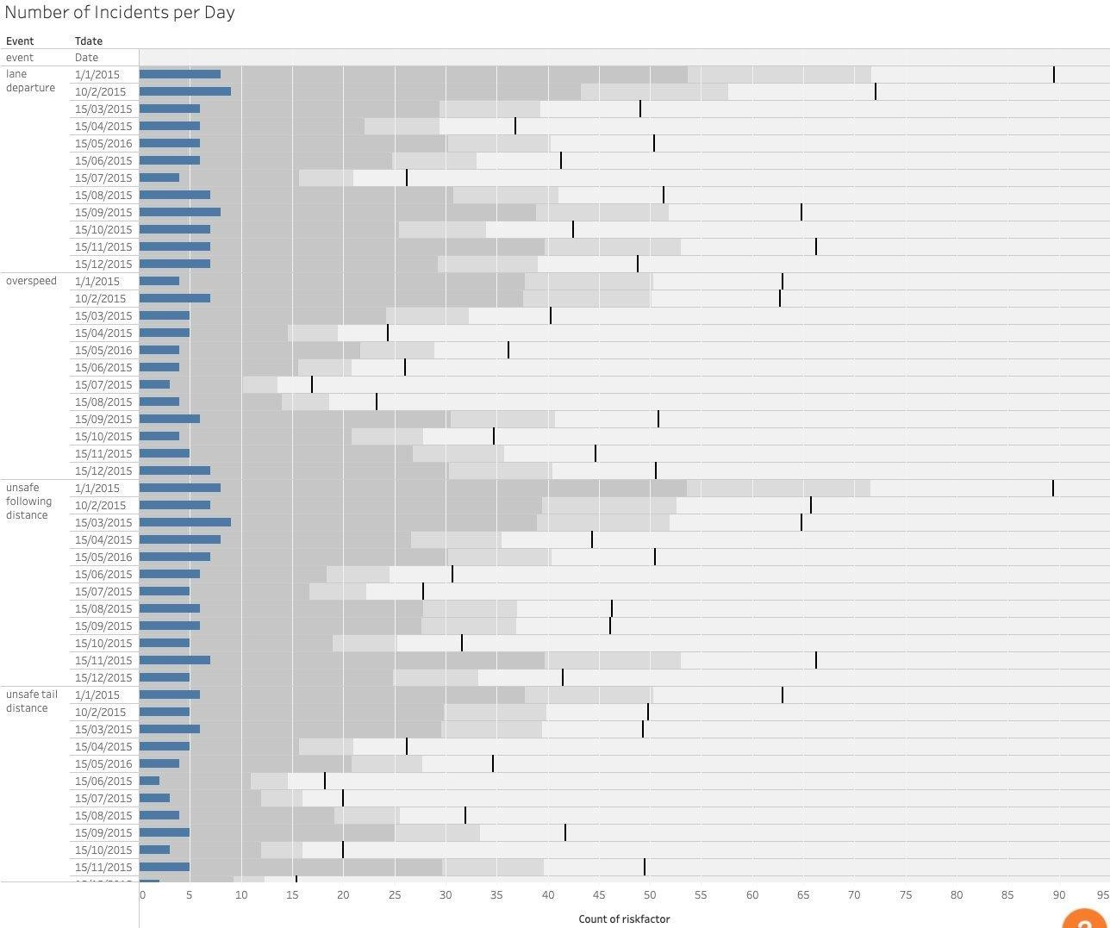
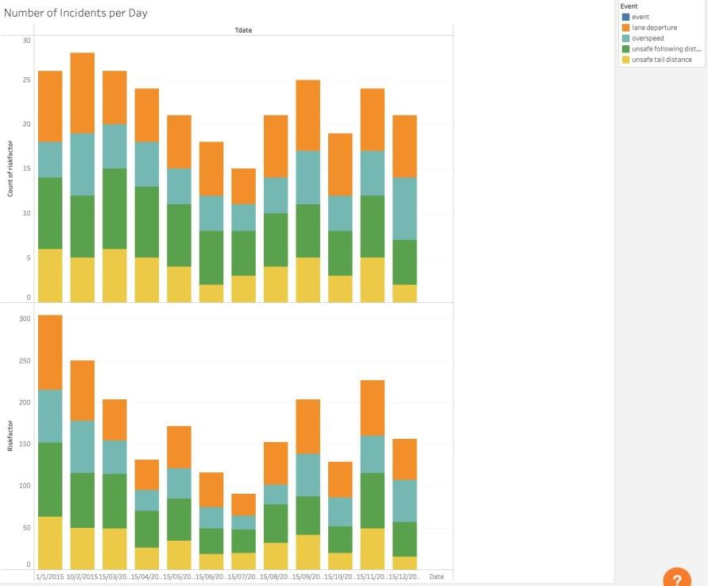
Dashboard 3 - Risk Model due to Incidents per Day

Slide 9
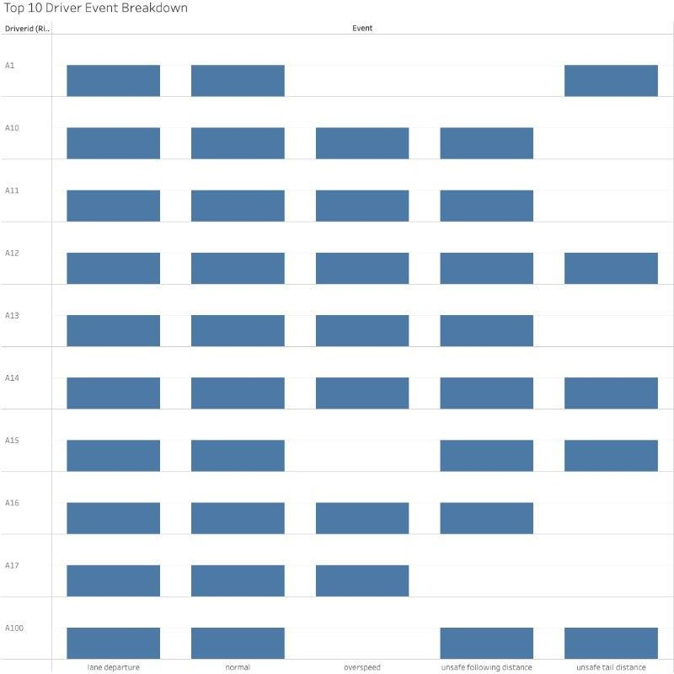
Dashboard 3 - Risk Model of Top 10 Driver Events
The model highlights that distribution of events per driver

Slide 10
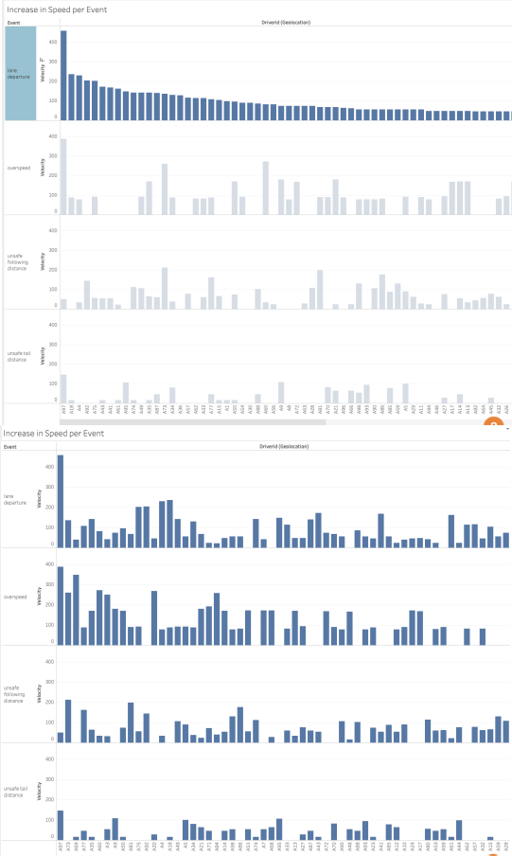
Dashboard 4 - Risk Model due to Speed
Model shows the increase in speed per event
The model highlights a direct correlation between an increase of speed and the occurrence of an event

Slide 11





Conclusion
To mitigate risk, we should:
Train drivers with the highest risk factors
Raise awareness of safe driving practices
Top rated drivers with the most miles to
train high-risk drivers

Slide 12
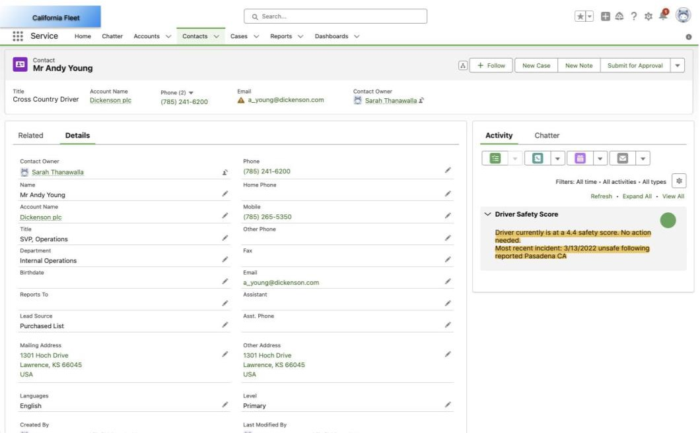

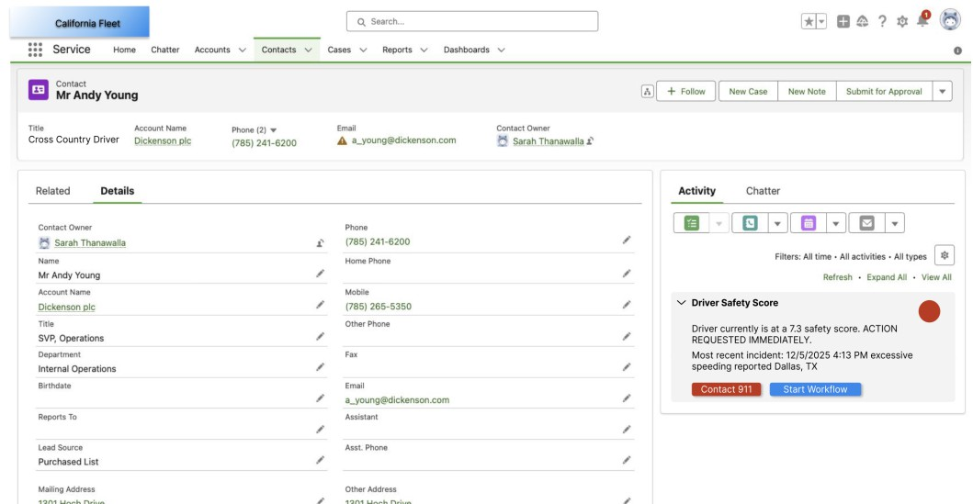
Extra Analysis: Salesforce

Slide 13

Thank you

